Slide 1
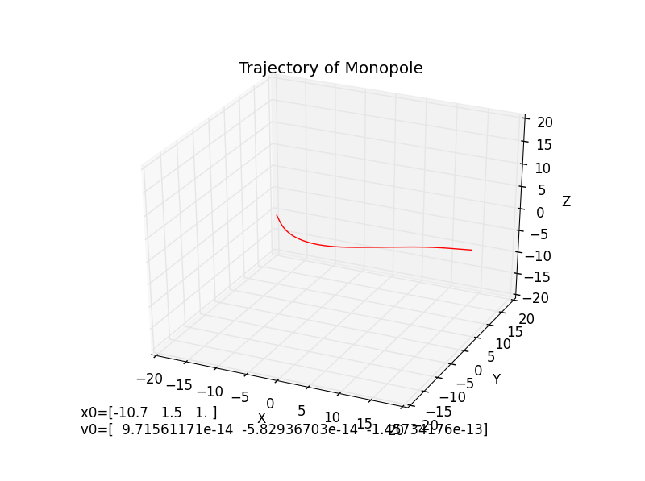
Magnetic Monopoles in the Milky Way Galaxy Felix Feist, New York University with Professor Glennys Farrar
Notes:
Image src: my own simulations

Slide 2
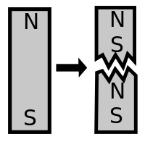
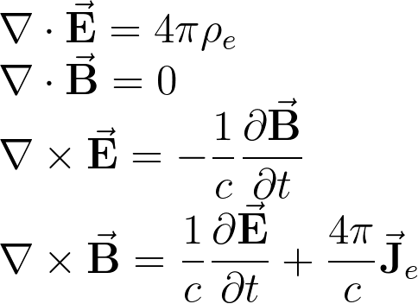
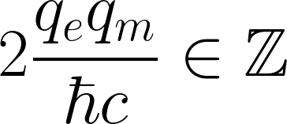
What are magnetic monopoles?
A theoretical particle whose magnetic field is like the field of a single-pole magnet.
A monopole would produce a divergent field like that of an electric charge.
Why do we believe in them?
Dirac quantization condition
Symmetry of Maxwell’s Equations
Predicted by GUTs
Dirac Quantization Condition (cgs)
Maxwell’s Equations (cgs)
Notes:
Image src: wikipedia

Slide 3
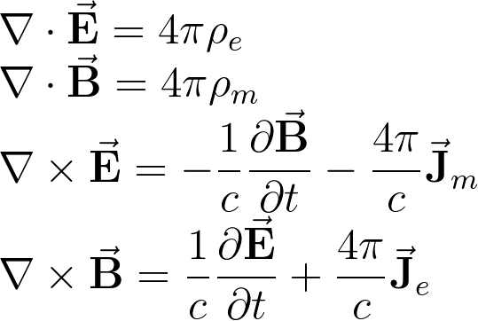
What are magnetic monopoles?
A theoretical particle whose magnetic field is like the field of a single-pole magnet.
A monopole would produce a divergent field like that of an electric charge.
Why do we believe in them?
Dirac quantization condition
Symmetry of Maxwell’s Equations
Predicted by GUTs
Dirac Quantization Condition (cgs)
Maxwell’s Equations (cgs)
Notes:
Image src: wikipedia

Slide 4
Searches for the elusive monopole
Many searches have been carried out…^{[2]}
In cosmic rays
In the Earth’s crust
Drifting through the atmosphere
Produced in particle accelerators
No statistically significant success.
There is hope: The mass is not known, but GUTs predict ~10¹⁵GeV/c^{2 [3]}. If correct, this single particle is 20x heavier than a human blood cell^{[4]} and 10¹⁵ times the mass of a proton.
Notes:
Src for this info: Sloan Non-collider searches for stable massive particles arXiv:1410.1374v1 [hep-ph] 6 Oct 2014 Src for 20x blood cell: wolfram alpha search “1e15GeV/c^2”

Slide 5

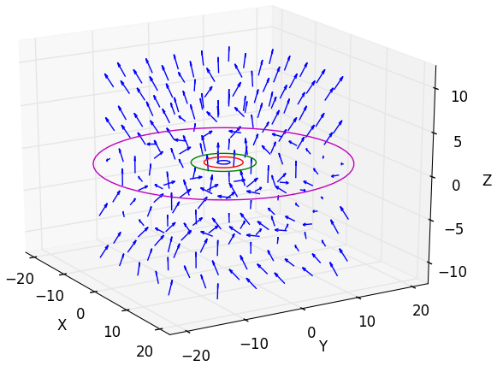

The Galactic Magnetic Field
In 2012, Professor Glennys Farrar came up with an improved model of the Milky Way magnetic field.^{[5]}
The motion of monopoles can now be studied more precisely.
Does the magnetic field shield us from monopoles? Simulations can provide an answer.
Fun fact: it is piecewise in ~30 pieces
Notes:
Src for this info: Sloan Non-collider searches for stable massive particles arXiv:1410.1374v1 [hep-ph] 6 Oct 2014 Src for 20x blood cell: wolfram alpha search “1e15GeV/c^2”

Slide 6
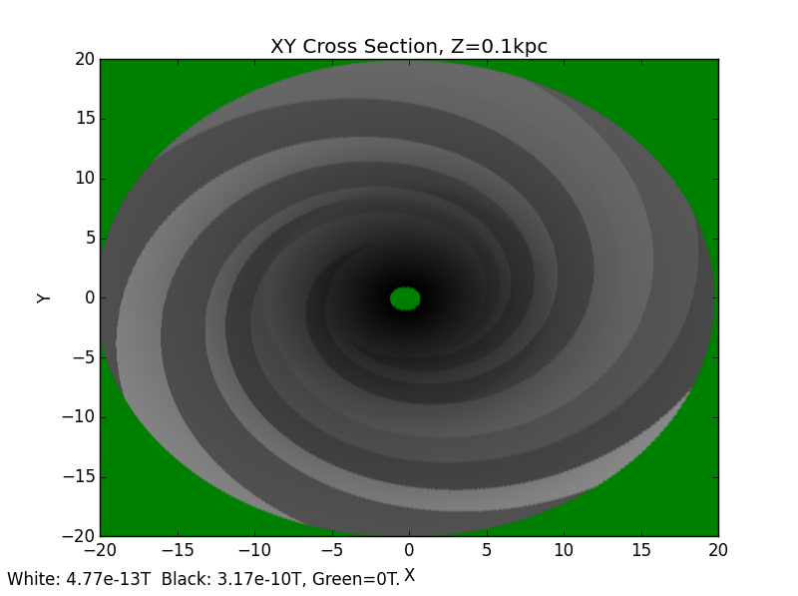
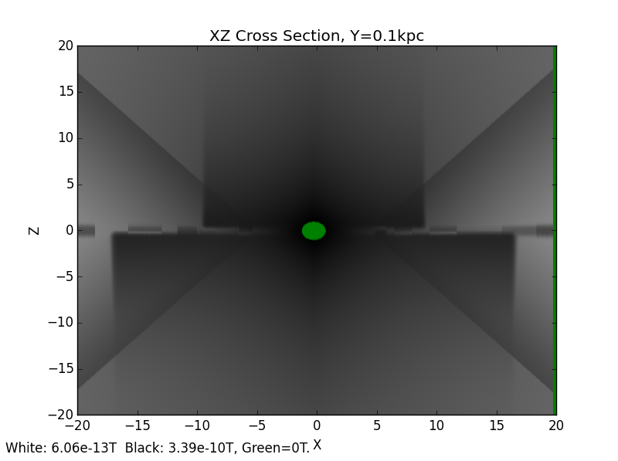
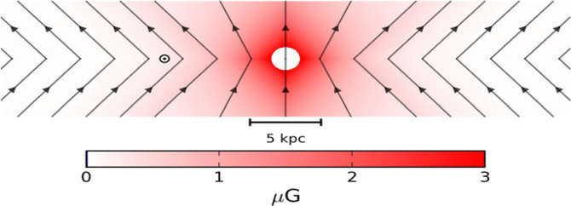
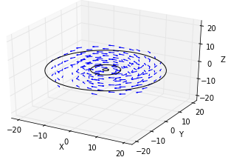
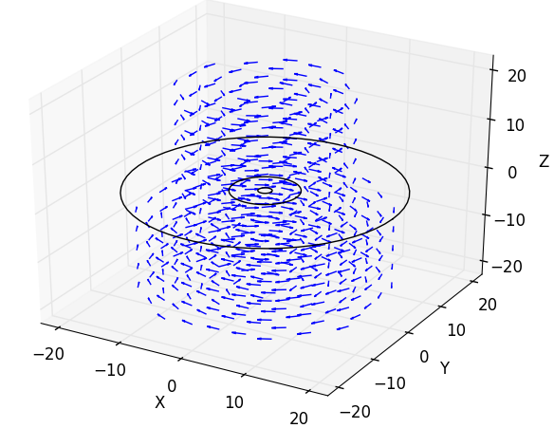
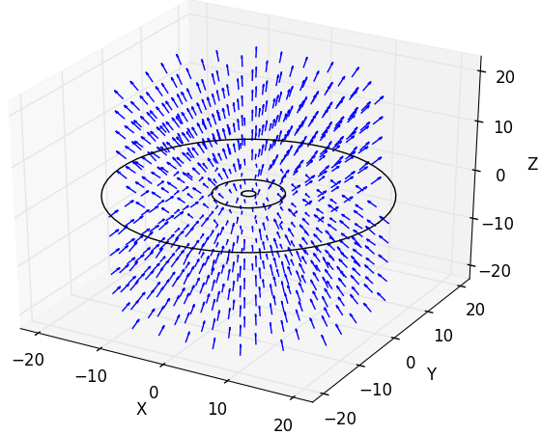
The field repels positive monopoles from the upper hemisphere & pulls them in from the lower hemisphere.
It works oppositely for negative monopoles.
Thus an isotropic flux to the Earth is reduced by at most 50%.
+
+
Disk Field
Halo Field
X-Field
Notes:
All diagrams in this slide are self-made.

Slide 7

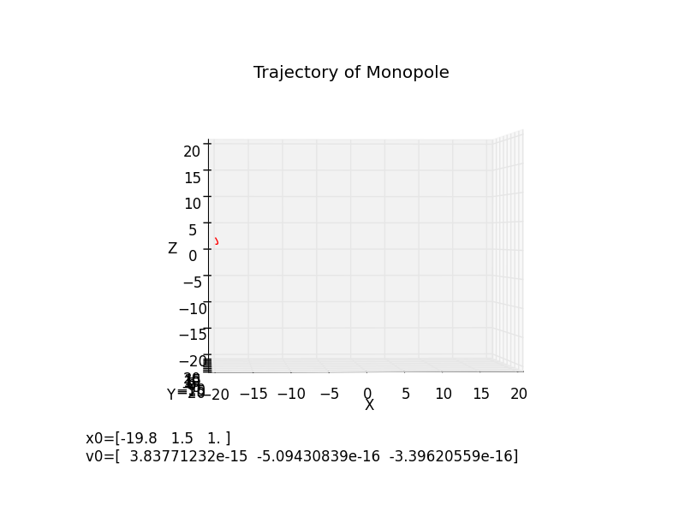
The Simulation
Wrote 4th order Runge-Kutta solver in Python to find out the energy at which monopoles can tunnel through to the earth
Dynamics had to be relativistic
Simple method: increase starting velocity until the monopole reaches r_{earth} = 8.5kpc
Gravitational field is negligible for monopoles with m << 1e17GeV/c² so it is not considered
X-field Component [5]
Notes:
X-field diagram taken from Jansson, Farrar (2012): A New Model of the Galactic Magnetic Field. The rest are a result of plotting my simulations.

Slide 8
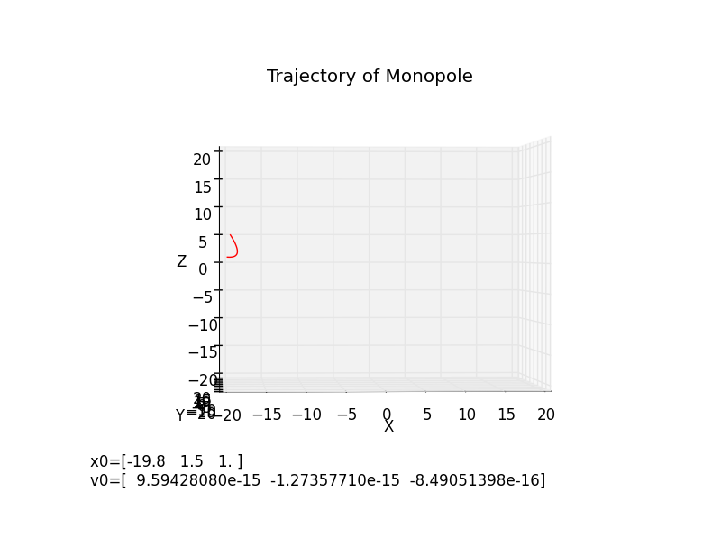
The Simulation
Wrote 4th order Runge-Kutta solver in Python to find out the energy at which monopoles can tunnel through to the earth
Dynamics had to be relativistic
Simple method: increase starting velocity until the monopole reaches r_{earth} = 8.5kpc
Gravitational field is negligible for monopoles with m << 1e17GeV/c² so it is not considered
X-field Component [5]
Notes:
X-field diagram taken from Jansson, Farrar (2012): A New Model of the Galactic Magnetic Field. The rest are a result of plotting my simulations.

Slide 9

The Simulation
Wrote 4th order Runge-Kutta solver in Python to find out the energy at which monopoles can tunnel through to the earth
Dynamics had to be relativistic
Simple method: increase starting velocity until the monopole reaches r_{earth} = 8.5kpc
Gravitational field is negligible for monopoles with m << 1e17GeV/c² so it is not considered
X-field Component [5]
Notes:
X-field diagram taken from Jansson, Farrar (2012): A New Model of the Galactic Magnetic Field. The rest are a result of plotting my simulations.

Slide 10
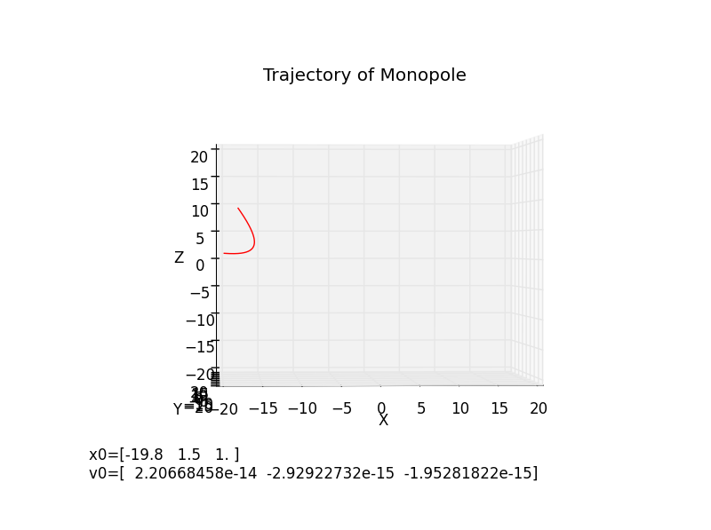
The Simulation
Wrote 4th order Runge-Kutta solver in Python to find out the energy at which monopoles can tunnel through to the earth
Dynamics had to be relativistic
Simple method: increase starting velocity until the monopole reaches r_{earth} = 8.5kpc
Gravitational field is negligible for monopoles with m << 1e17GeV/c² so it is not considered
X-field Component [5]
Notes:
X-field diagram taken from Jansson, Farrar (2012): A New Model of the Galactic Magnetic Field. The rest are a result of plotting my simulations.

Slide 11

The Simulation
Wrote 4th order Runge-Kutta solver in Python to find out the energy at which monopoles can tunnel through to the earth
Dynamics had to be relativistic
Simple method: increase starting velocity until the monopole reaches r_{earth} = 8.5kpc
Gravitational field is negligible for monopoles with m << 1e17GeV/c² so it is not considered
X-field Component [5]
Notes:
X-field diagram taken from Jansson, Farrar (2012): A New Model of the Galactic Magnetic Field. The rest are a result of plotting my simulations.

Slide 12
Results
Monopoles can tunnel through to the earth at initial kinetic energies of ~5e10 GeV or more, but only from ideal angles of entry.
Starting at kinetic energies of ~1.3e12 GeV, monopoles can reliably reach the earth from any angle.
Consistent with order-of-magnitude calculations.
Independent of monopole mass!
=> Total flux to the earth is halved for monopoles with kinetic energy less than 5e10GeV. It then increases with monopole energy until 1e12GeV, at which point it is unaffected by the magnetic field.

Slide 13
Discussion
Wick (2002) estimates that relic monopoles are distributed with mean Kinetic Energy ~7e12 GeV
The breaking point at which the Flux is unaffected is 1.3e12 GeV
=> Relic monopoles are unaffected by the galactic field.
Lower energy monopoles may be produced by other sources. If less than 5e10GeV, we are being shielded from them. This means that if cosmic ray monopoles exist, detection experiments may receive a reduced flux and a bias of monopole charge which depends on the latitude/longitude of the detector.
Error due to ~10% uncertainty in field. No timestep or machine precision error.

Slide 14
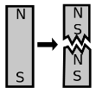
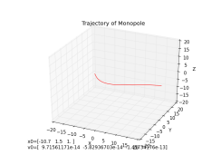
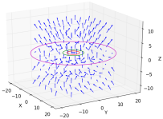
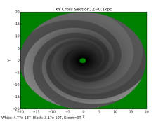


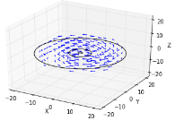
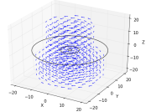

References
[1] image from wikipedia: Magnetic Monopoles
[2] List of monopole searches from Sloan, Non-collider searches for stable massive particles arXiv:1410.1374v1 [hep-ph] 6 Oct 2014
[3] http://moedal.web.cern.ch/content/search-magnetic-monopole
[4] Red blood cell mass from Wolfram Alpha search for “1e15GeV/c^2”
[5] Galactic field model from “A New Model of the Galactic Magnetic Field” (Jansson, Farrar 2012): The Astrophysical Journal, 757:14 (13pp), 2012 September 20
I produced all other diagrams in Python using matplotlib:

